Slide 1
Prepared by Adonna Jardine-Comrie, PhD
"Environmental Stewardship for Line Supervisors"

Slide 2
Module Objectives
Upon completion of this module, participants should be able to:
Knowledge:
Understand how their activities at home and at work contribute to local, national and global environmental problems.
Define the concept environmental stewardship.
List the principles underlying environmental stewardship.
Identify the challenges associated with implementing an environmental stewardship programme at home and at the office.

Slide 3
Performance / Skill
Implement a personal environmental stewardship programme involving resource conservation and pollution prevention.
Plan and implement an environmental stewardship programme at their workplace.
Devise strategies to overcome the challenges associated with implementing an environmental stewardship programme at home or at the office.

Slide 4
Attitude
Feel a personal sense of responsibility to care for the natural environment.
Appreciate the value of their individual actions in environmental protection.
Commit to utilizing knowledge and competence in a personal environmental stewardship programme, and educating and encouraging others to do likewise.

Slide 5
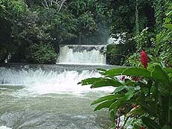
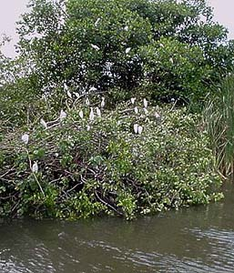
What is the Environment?
All living & non-living external factors that affect an organism

Slide 6
Environmental Goods and Services:
Food
Potable water
Breathable air
Recreational / Spiritual Benefits
Resources for our economic activities
Waste assimilation

Slide 7
Environmental Problems
Resource Depletion:
Environmental goods (natural resources) are used up faster than they can be replenished.
Pollution:
The waste assimilation mechanism is overwhelmed.

Slide 8
Environmental Problems
Resource Depletion
Renewable resources (water, forest, soil, biological resources)
Nonrenewable resources (metals, fossil fuels i.e. coal, oil and natural gas)
Pollution
Air
Land
Water

Slide 9
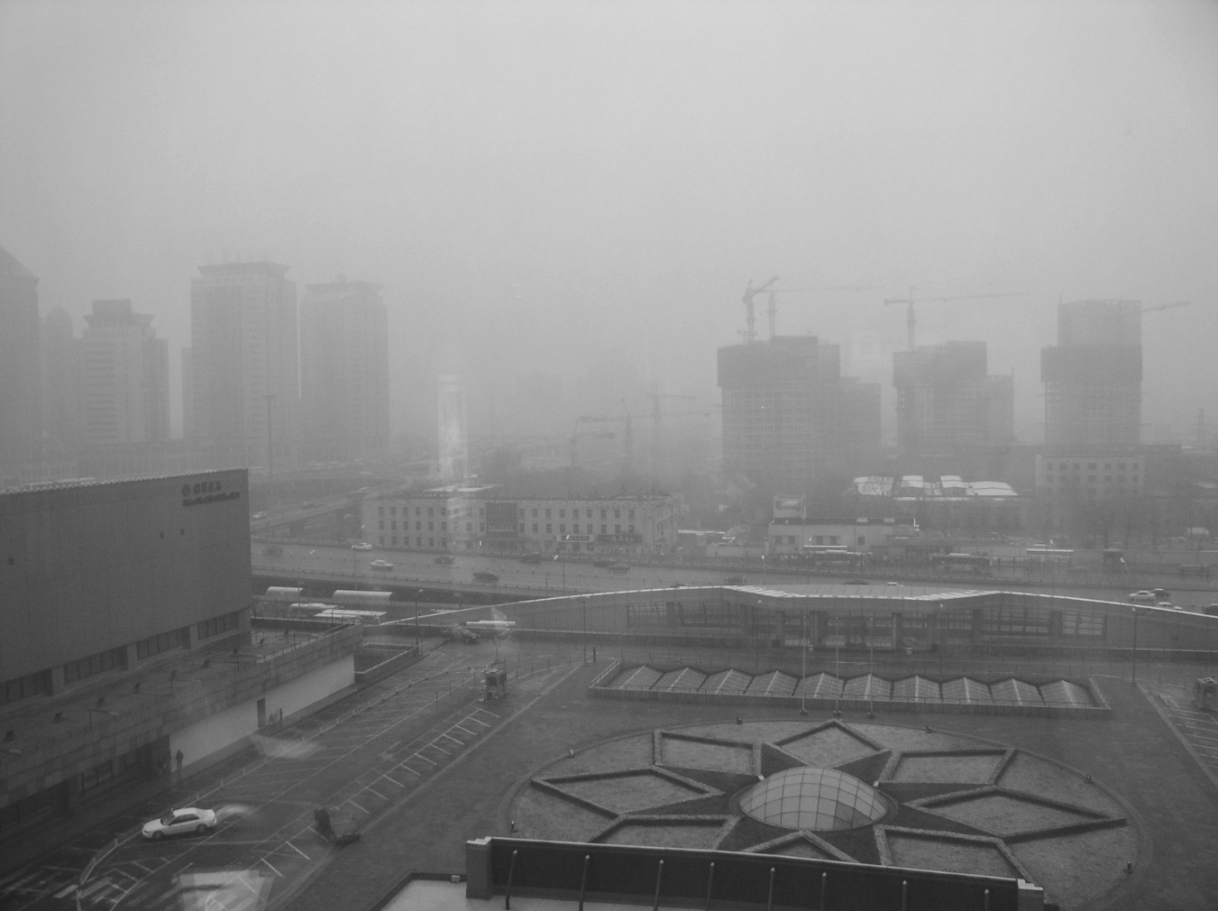
http://www.significancemagazine.org/SpringboardWebApp/userfiles/sig/image/fanshawe/Beijing.jpg

Slide 10
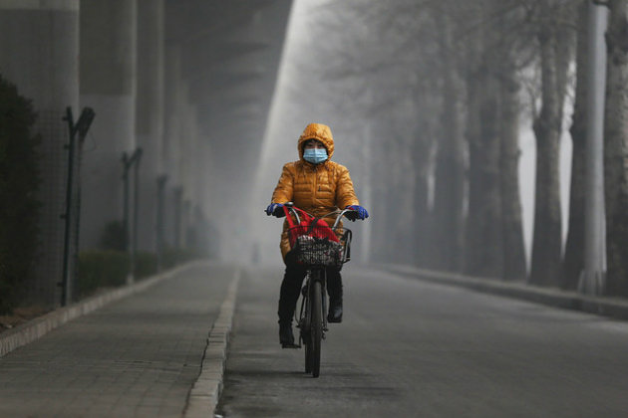
“Airpocalypse”
A 2007 report entitled “Cost of Pollution in China” discussed premature deaths and the report’s authors concluded that 350,000 to 400,000 people die prematurely in China each year because of outdoor air pollution.
The problem, of course, is not limited to China. In India, 620,000 deaths were blamed on outdoor air pollution in 2010, according to the study.
By 2050, the number of premature deaths from exposure to particulate matter is projected to more than double reaching 3.6 million a year globally, with most deaths occurring in China and India.
Adapted Article authored by Dylan Stableford, Yahoo! News 2013

Slide 11
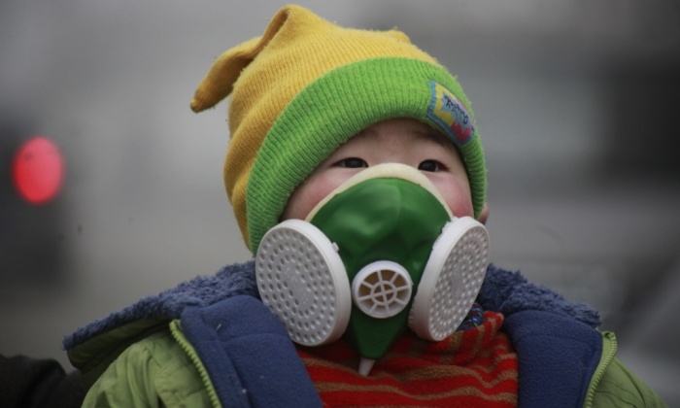
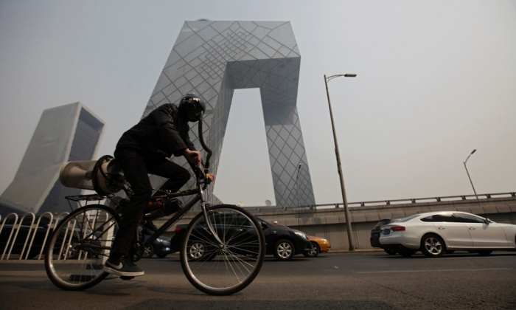
Heavy-duty face masks are now frequently seen on Beijing’s streets. Photograph: Imaginechina/Corbis
British artist Matt Hope has designed a ‘breathing bicycle’ which filters air as you pedal, then feeds it into your mask. Photograph: Petar Kujundzic/Reuters

Slide 12
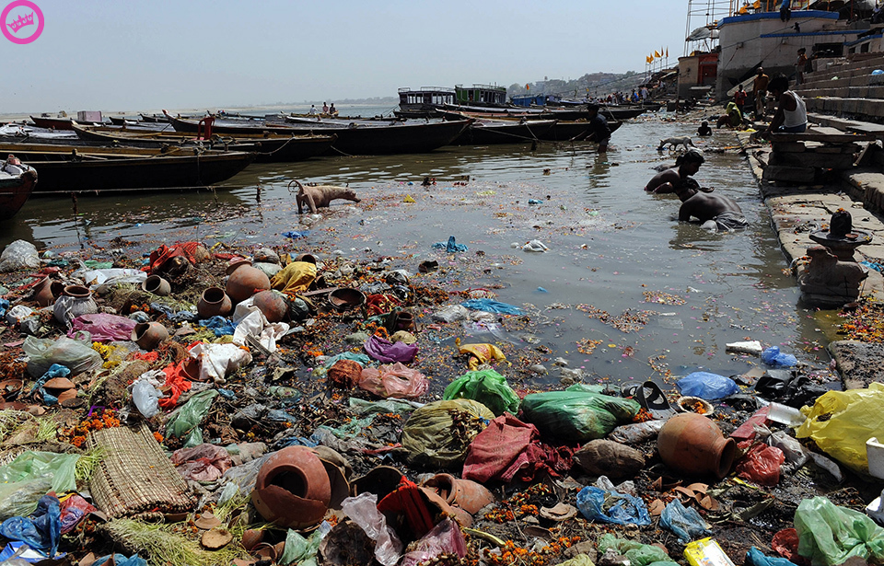
What is the issue here?
http://shipbright.files.wordpress.com/2010/02/ganges-pollution.jpg

Slide 13
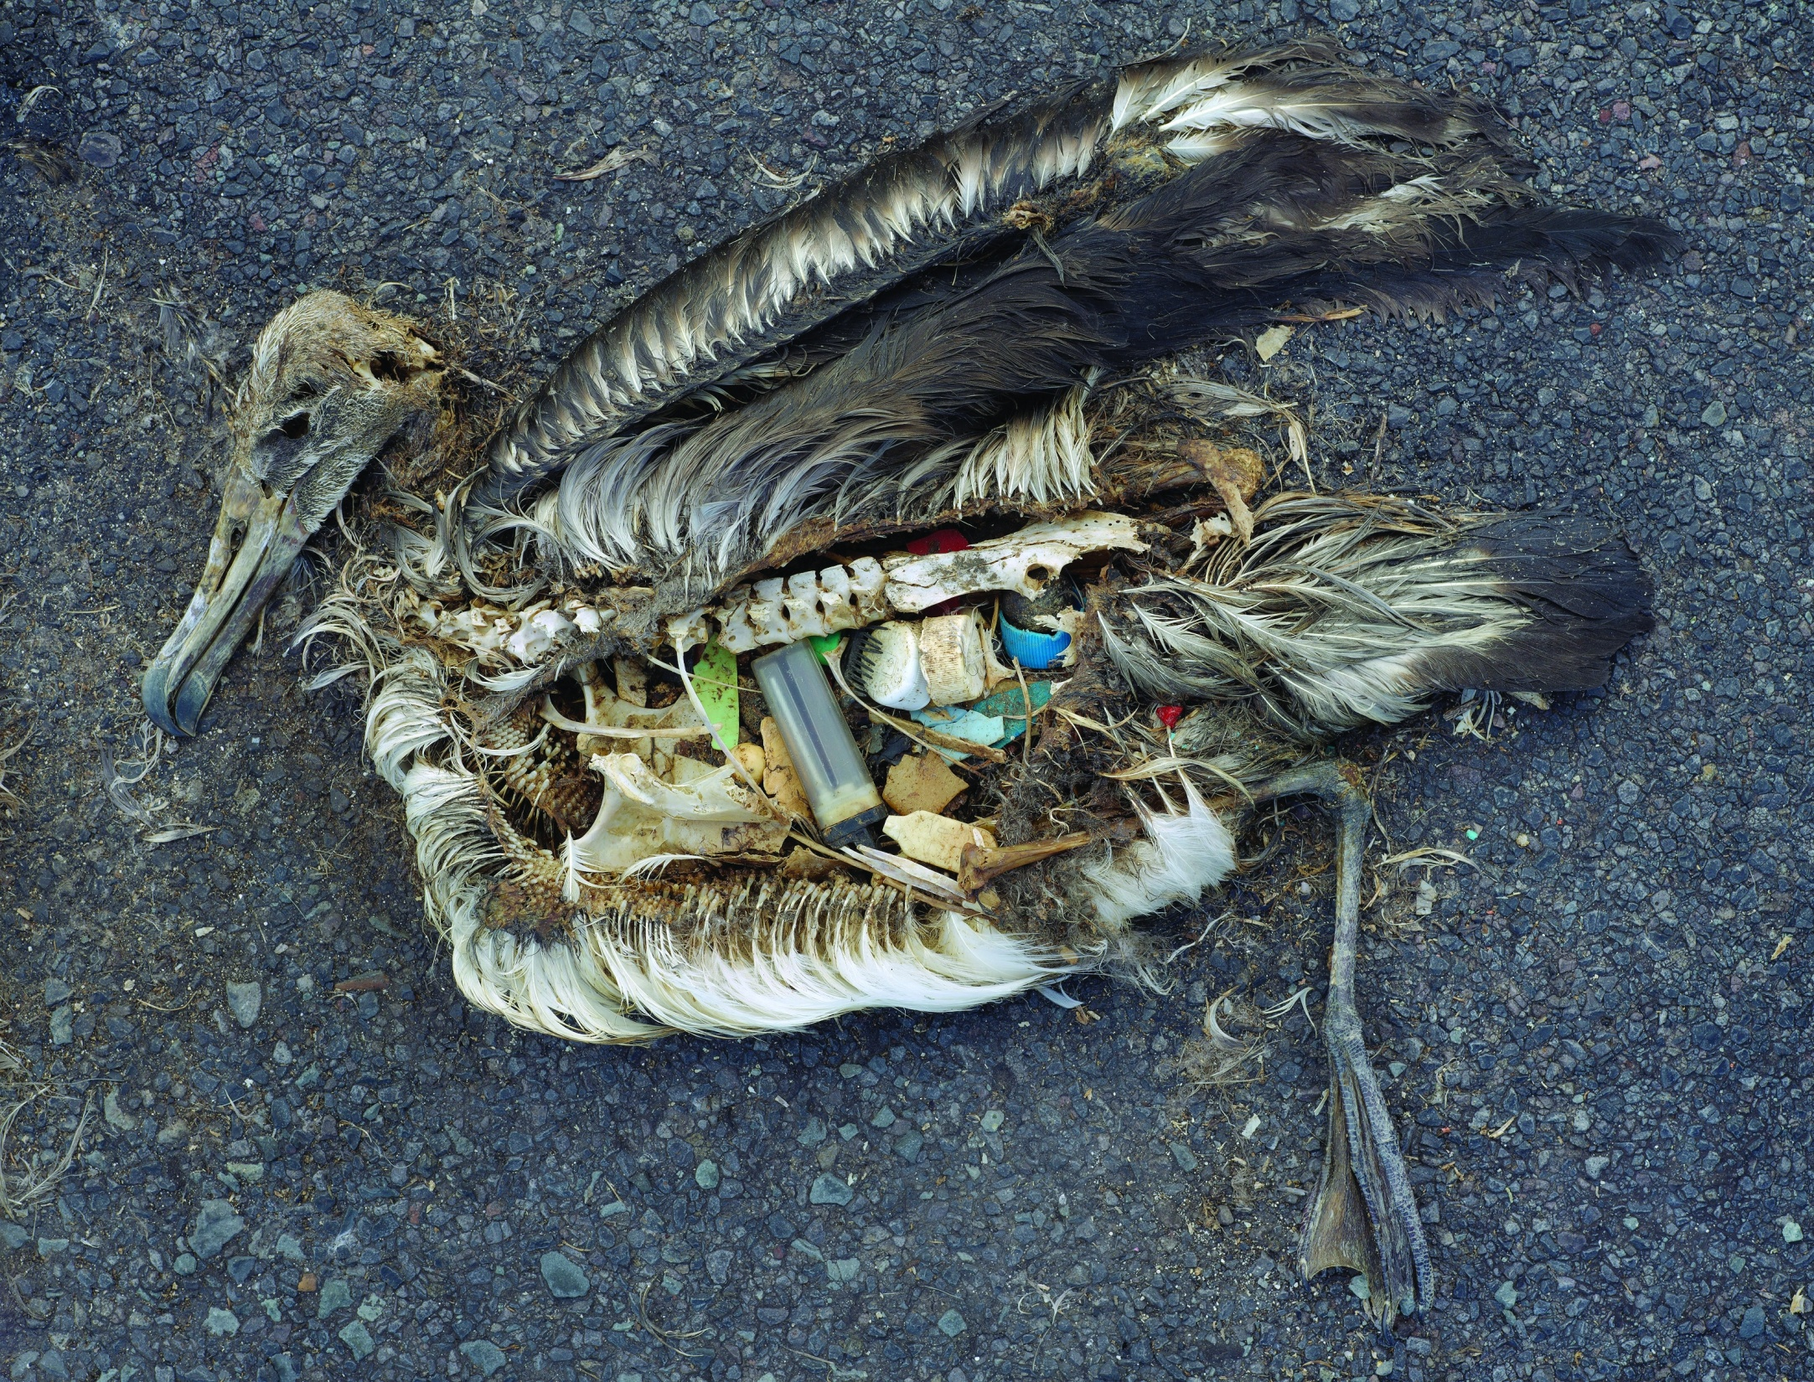
http://site.bobowrap.com/blog/wp-content/uploads/2010/04/bird-plastic.jpg

Slide 14
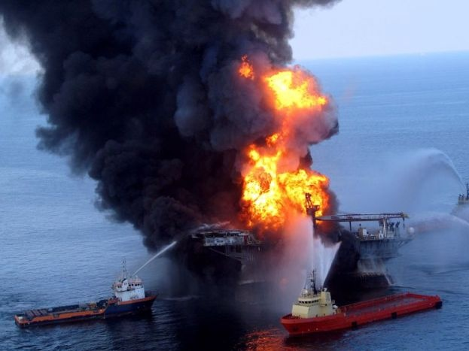
http://www.abc.net.au/news/image/407722-3x2-700x467.jpg April 20, 2010

Slide 15
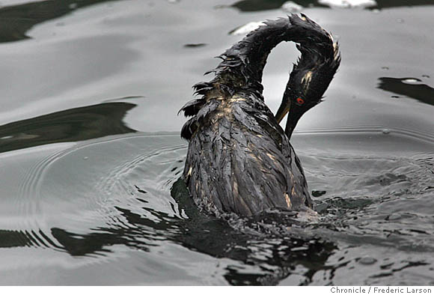

Slide 16
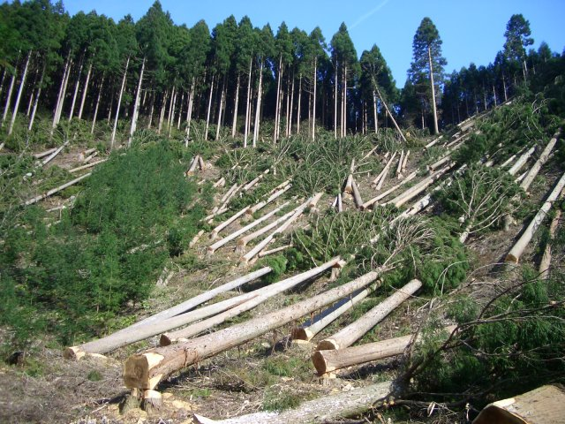

Slide 17
The use of other consumer products
One of the biggest culprits in ocean pollution is phosphates, common in laundry detergents and some cleaning products. The average consumer nationwide uses about 30 pounds of laundry detergent a year.
Disposal of liquid waste
The oil from just one oil change for your car is enough to contaminate one million gallons of fresh water (U.S. Environmental Protection Agency, 2003)

Slide 18
Paper use
It takes 17 trees to make one ton (1000 kg) of paper.
In 1996 the average worldwide annual paper consumption is 48 kg per person (almost 1 tree [.81] per person per year).
Paper consumption per person was estimated to double by 2010 (Food and Agriculture Organization of the United Nations, 1997).
Paper manufacturing is the largest industrial user of water per pound of finished product. To produce 1 kg of paper approximately 324 litres of water is required.
Dioxin is a by product of paper bleaching using elemental chlorine.
10,000 trees are cut down annually in China to make holiday cards.
Source: Xinhua News Agency

Slide 19
Dioxin is a carcinogen but exposure has been linked to birth defects, inability to maintain pregnancy, decreased fertility, reduced sperm counts, endometriosis, diabetes, learning disabilities, immune system suppression, lung problems, skin disorders, lowered testosterone levels and much more.
The major sources of dioxin are in our diet. Since dioxin is fat-soluble, it bioaccumulates, climbing up the food chain.
In fish, these toxins bioaccumulate up the food chain so that dioxin levels in fish are 100,000 times that of the surrounding environment

Slide 20
Video Presentation “Climate Change”

Slide 21
Discussion Questions (One)
What is the root cause of our problems with global warming and climate change?
How will Jamaica be affected by climate change?
How will climate change affect you (your family) and your company/organisation?
What steps (if any) can we take to mitigate and or adapt to climate change?

Slide 22
Video Presentation “The Story of Bottled Water”

Slide 23
Discussion Questions (Two)
What was the most significant aspect of the video for you, and why?
What are the environmental problems associated with drinking bottled water?
How does the video clip demonstrate that environmental problems are related to political, economic and cultural issues?
How are these issues related to you as an individual and to your role as a supervisory manager?

Slide 24
Environmental Reality Check
Without changes in our behaviour and mode of operations we are heading for catastrophe.
People talk about saving the planet but it is the life supporting functions of the planet that are being destroyed so the real issue is saving ourselves, our children and grandchildren.

Slide 25
Introducing Environmental Stewardship What is environmental stewardship? Who is an environmental steward?

Slide 26
Definitions
According to the United States Environmental Protection Agency, environmental stewardship is the responsibility for environmental quality shared by all those whose actions affect the environment.
Environmental stewardship refers to responsible use and protection of the natural environment, through resource conservation and pollution prevention practices.

Slide 27
Environmental Stewardship
Embodies the concept of a Green Office, a Green School or Green Home which is conceptualized as smarter and better as it is:
Ecological - using non-toxic, recycled, environmentally friendly products and supplies
Efficient – using as little energy and other resources as possible and putting out the smallest amount of waste as possible
Healthy – will generate as little visual, noise and physical pollution as possible.

Slide 28
Why should one aspire to be an environmental steward?

Slide 29
Key Drivers for Individual Environmental Stewardship
Responsibility to the creator
Concerns about inter and intra-generational equity
Concerns about economic and social catastrophe resulting from environmental degradation
Acknowledgement of personal responsibility
Ecological /environmental foot print
measures the amount of natural resources consumed by an individual
measures an individual’s impact on the natural environment

Slide 30
"Everyone thinks of changing the world, but no one thinks of changing himself." ~ Leo Tolstoy (1828 - 1910) Russian Novelist, Poet, Ethicist

Slide 31
Questions for Discussion: What are the benefits of environmental stewardship to an individual and to a company?

Slide 32
Benefits Environmental Stewardship to Companies / Organisations
Increased efficiency and reduced consumption and waste translates into financial savings. Improve image and reputation can also boost business.
Healthier working environment increases workers’ productivity, attracts high quality workers.
Protection of the natural environment on which the company’s continued existence depend.
Triple bottom line (John Elkington, 1994)
Planet - Ecological
Profit - Economic
People - Social (corporate social responsibility)

Slide 33
Principles of Environmental Stewardship
Core Principle 1:Resource Conservation – making the most efficient use of resources (materials, energy and water) through:
Energy Efficiency and Conservation
(What is the difference between efficiency and conservation?)
Water Efficiency and Conservation
Solid Waste Management and Conceptualizing Waste as a Resource
Publications Management
Events Management

Slide 34
Principles of Environmental Stewardship
Core Principle 2: Pollution Prevention – minimizing contamination of the environment by chemicals or other materials through:
Vehicle/Fleet Management
Management of the Use of Chemicals and Other Hazardous Substances
Reduction in resource use

Slide 35
Principles of Environmental Stewardship
Core Principle 3: Health and Safety
Managing Indoor Air Quality
Comfort and Productivity in the Workplace
Emergency and Disaster Management

Slide 36
BREAK

Slide 37
Implementing an Environmental Stewardship Programme at the Work Place
Carry out an environmental assessment
Resource use
Waste generation (solid, liquid, gaseous)
Identify priority areas for change
Start with easy wins
Design measurable and reportable challenges.

Slide 38
Video Presentation “Reducing Your Office Foot Print”

Slide 39
Group Activity ( 5 - 7 persons per group)
Devise strategies for an environmental stewardship programme at your work place focusing on the following areas:
The conservation of Energy
Lighting
Electronic equipment use
Transportation
The conservation of Water
Solid Waste (garbage) management

Slide 40
Group Activity (cont’d)
Make Predictions about the challenges you would face in bringing about change at your workplace
Suggest possible strategies for overcoming these challenges
Time Allotment
15 minutes for group discussion
5 minutes each for group presentations

Slide 41
Tips for Energy Management
LIGHTING
Use compact fluorescent energy saving bulbs rather than incandescent bulbs
Replace old fluorescent lighting fixtures using T-12 lamps with T-8 fluorescent lamps for better color, less flickering and 20 percent less energy use
T12 and T8 refer to diameters of lamp tubes.
Top-quality T8 lamps function with reduced mercury

Slide 42
Light exit signs with lower energy bulbs like compact fluorescent lamps (CFLs), light emitting diodes (LEDs), neon lighting or electroluminescent lighting technology.
Check out occupancy sensors for areas of the office that aren’t used as much, such as the break or conference room
Quick Stats
Replacing tungsten bulbs with compact fluorescent lamps (CFL) typically makes an immediate cost savings of between 50-80 percent, and CFLs last up to 10 times longer than incandescent bulbs. Ideally when they do burn out, CFLs should be recycled.

Slide 43
Over its life span, a fluorescent tube will save 640 kWh of electricity compared with the equivalent 100-watt standard bulb. This reduces the production of carbon dioxide, a green house gas, by half a ton and sulphur dioxide, which causes acid rain, by 3 kg.
According to a US Department of Energy (DOE) end use study from 1995, lighting accounts for about 29 percent of the energy use in a typical office.

Slide 44
EQUIPMENT
Turn machines off when you leave the office for the night
A Lawrence Berkeley Lab study from 1999 estimated that one workstation (computer and monitor) left on after business hours is responsible for power plants emitting nearly one ton of CO2 per year.
Activate sleep mode for printers, copiers and fax machines so they’ll sense inactive periods
Consider consolidating these machines by purchasing a machine that performs multiple office functions.

Slide 45
It’s estimated (Microsoft) that simply by placing PCs in sleep mode, an organization could:
Reduce greenhouse gasses by half a ton annually for each computer;
Reduce greenhouse emissions by the equivalent of one car for each 10 computers;
Reduce costs by $707.70 US for every 100 computers.
If you’re looking to purchase new office equipment, look for ENERGY STAR qualified products to cut down energy use and pollution

Slide 46
Ink-jet printers use less energy than laser models
Locate the fridge where air can circulate around the coils at the back in a cool spot away from the oven or the sun. This can save up to 150 kilograms of greenhouse gas each year
Fresh food compartments should be set at around 4°C to 5°C and freezers should optimally be set between -15°C and -18°C

Slide 47
TRANSPORTATION / VEHICLE MANAGEMENT
Buy fuel efficient vehicle
Drive smart
go easy on the brakes and gas pedal, avoid hard accelerations, reduce time spent idling and unload unnecessary items in your trunk to reduce weight.
If you have a removable roof rack and you are not using it, take it off to improve your fuel economy by as much as 5 percent.
Use overdrive and cruise control on your car if you have those features.

Slide 48
Tune your vehicle
A well-maintained car is more fuel-efficient, produces fewer greenhouse gas emissions, is more reliable, and is safer!
Check your tires
Check your tire pressure regularly. Under-inflation increases tire wear, reduces your fuel economy by up to 3 percent, and leads to increased emissions of greenhouse gases and air pollutants.
Reduce miles you drive
Use Renewable Fuels
E10, biodiesel
Biodiesel is a renewable fuel made from agricultural resources such as vegetable oils.

Slide 49
Tips for Water Conservation
Fix leaks.
Install a low-flush or dual flush toilet.
Toilet flushing uses as much water in a day as you drink in a whole month.
An old-style single-flush toilet could use up to 12 litres of water per flush. A standard dual flush toilet uses only three litres on a half-flush
Create your own low flush loo by filling one or more plastic bottles with water and placing them in the cistern to reduce the volume of water used per flush.

Slide 50
Install aerators on taps which use 50 percent less water than standard taps. You can buy tap aerators from hardware and plumbing shops for a few dollars. They are easy to install yourself; Just unscrew your old tap and replace it
Practice water conservation when taking a shower, brushing teeth or washing hands
Fit a water-efficient shower head. A standard showerhead may use up to 25 litres of water per minute. A water-efficient showerhead might use as little as seven litres per minute (these should not be fitted to electric showers as this can lead to overheating of the water)

Slide 51
Tips for Waste Management
Reduce
Reuse
Recycle
Use durable towels, tablecloths, napkins, dishes, cups, and glasses.
Bring re-useable cutlery (reuse plastic forks and spoons)
Buy rewritable CDs, or use a USB flash drive rather than one-use CDs or DVDs to reduce waste
Reduce printing

Slide 52
Print on both sides paper
Use a stick-on label on the first page of a fax instead of a full cover sheet.
When buying paper, buy recycled paper made from a high percentage of post-consumer recycled content.
A ton of 100 percent recycled paper saves the equivalent of 4,100 kWh of energy, 7,000 gallons of water, 60 pounds of air emissions, and three cubic yards of landfill space.

Slide 53
Look for paper that is processed chlorine free (PCF) because its produced without elemental chlorine or chlorine derivatives.
Use unbleached and uncolored paper. If you need to use colored paper, use pastel colors.
Use incoming packaging materials for outgoing shipments.
Construct a compost pit for food scraps and other biodegradable waste
Purchase products in bulk
Make sure employees have bins to recycle paper at their desk.

Slide 54
Health and Safety
KEY AREAS OF FOCUS
Hazardous materials
Indoor air quality
Ergonomics

Slide 55
The Home and Work Environment
May expose many persons to health hazards:
Injuries
Respiratory diseases
Cancer
Musculoskeletal and reproductive disorders
Mental and neurological illnesses
Eye damage and hearing loss
Communicable diseases

Slide 56
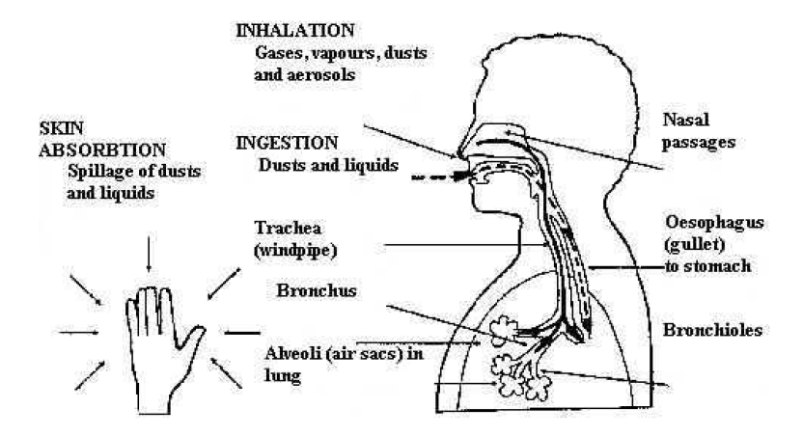
ROUTES OF ENTRY/ HEALTH EFFECTS

Slide 57
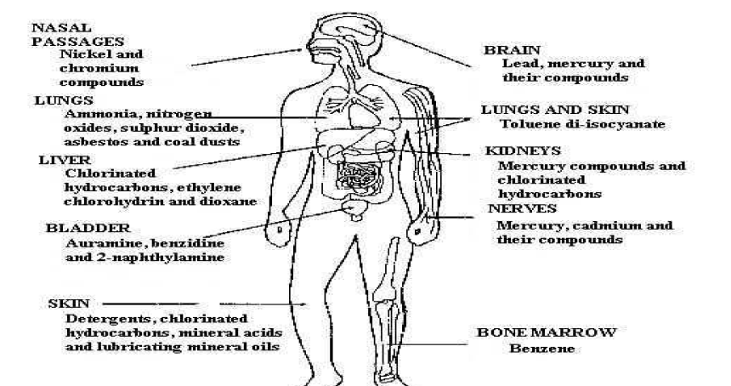
TYPE OF SUBSTANCE / BODY ORGAN IT EFFECTS

Slide 58
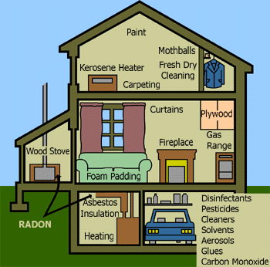
Sources of Hazardous Material in the Home and Working Environment
Cleaning and maintenance products.
Office equipment and products such as photocopiers, laser printers, adhesives, inks and correction fluid, can pose a health risk to users and building occupants.
Many office products may be harmful to the environment if not disposed of properly.

Slide 59
Toner
Ultraviolet Light
Ethylene Glycol and Acetone
Asbestos
Formaldehyde
Trichloroethylene
Ammonia/ Isopropyl Alcohol
Benzene

Slide 60
Sources
Formaldehyde
Benzene
Foam Insulation Plywood & Particle Board Carpeting Furniture Paper Tissues Household Cleaners
Tobacco Smoke Petrol Synthetic Fibers Plastics Inks Rubber Detergents

Slide 61
Trichloroethylene
Dry Cleaning Inks Adhesives

Slide 62
Indoor Air Quality – Definition
The physical, chemical and biological characteristics of air within a habitable structure.
Factors affecting indoor air quality
Ventilation
a combination of processes which results in the supply and removal of air from inside a building. These processes typically include bringing in outdoor air, conditioning and mixing the outdoor air with some portion of indoor air, distributing this mixed air throughout the building, and exhausting some portion of the indoor air outside.
Biological organisms (e.g. mold)
Chemical use / Building materials and furnishings

Slide 63
Indicators of Poor Indoor Air Quality
Malaise (lethargy)
Frequent headaches
Stress
Absenteeism
Loss of productivity

Slide 64
Plants ARE Good for Offices!
Common indoor plants may provide a valuable weapon in the fight against rising levels of indoor air pollution. Those plants in your office or home are not only decorative, but NASA scientists are finding them to be surprisingly useful in absorbing potentially harmful gases and cleaning the air inside modern buildings.
NASA and the Associated Landscape Contractors of America (ALCA) have announced the findings of a 2-year study that suggest a sophisticated pollution-absorbing device: the common indoor plant may provide a natural way of helping combat "Sick building syndrome.

Slide 65
Top 10 plants most effective in removing: formaldehyde, benzene, and carbon monoxide from the air
Common Name | Scientific Name
Bamboo Palm | Chamaedorea Seifritzii
Chinese Evergreen | Aglaonema Modestum
English Ivy | Hedera Helix
Gerbera Daisy | Gerbera Jamesonii
Janet Craig | Dracaena "Janet Craig"
Marginata | Dracaena Marginata
Mass cane/Corn Plant | Dracaena Massangeana
Mother-in-Law's Tongue | Sansevieria Laurentii
Pot Mum | Chrysantheium morifolium
Peace Lily | Spathiphyllum "Mauna Loa"
Warneckii | Dracaena "Warneckii"

Slide 66
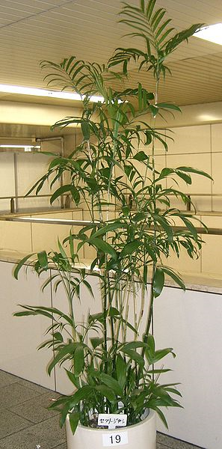
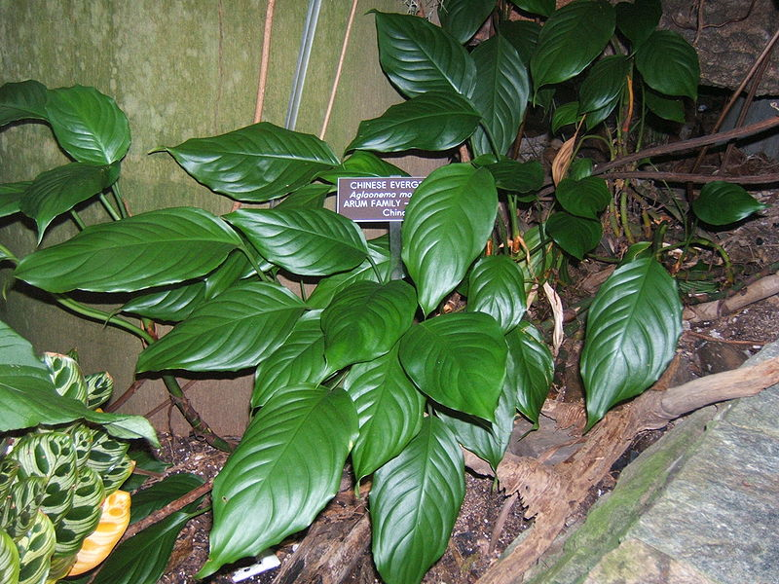
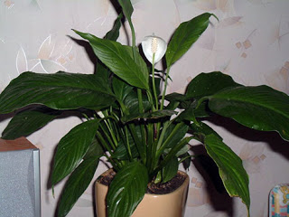
Chinese Evergreen
English Ivy
Bamboo Palm

Slide 67
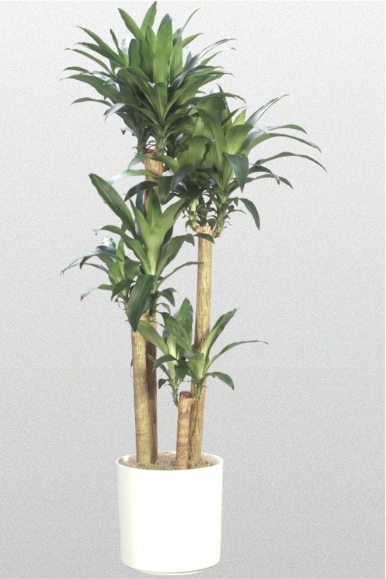
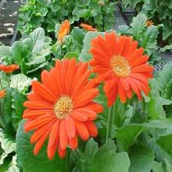
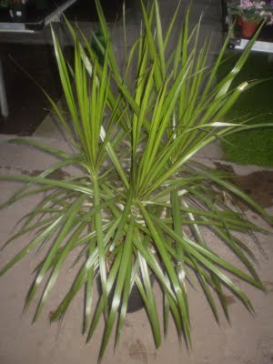
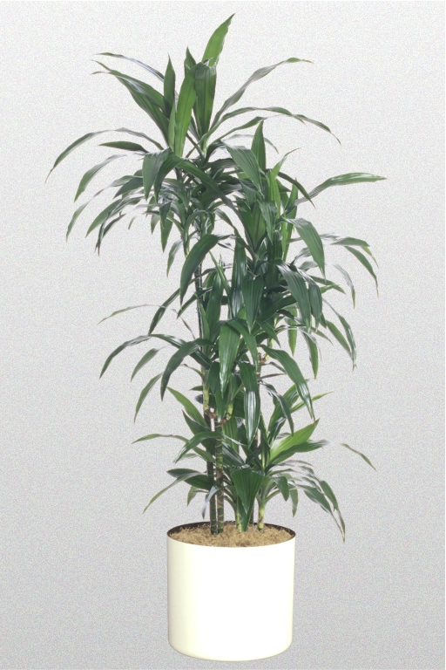
Gerbera Daisy
Marginata
Mass corn
Draceana Janet Craig

Slide 68
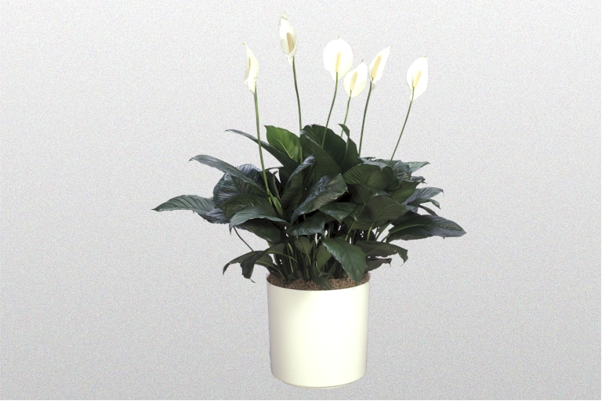
Spathiphyllum (Peace Lily)
Sansevieria (Snake Plant or Mother-in-Law’s tongue

Slide 69
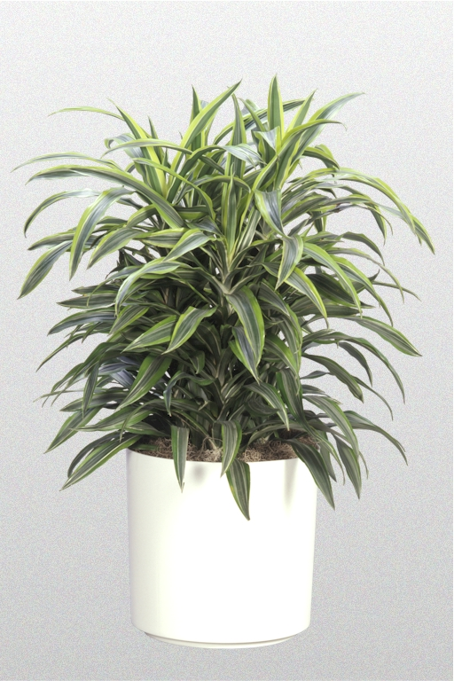
Dracaena Warneckii
Pot Mum

Slide 70
Ergonomics - Definition
Fitting work to people
Process of designing or arranging workspaces, products and systems so that they fit the people who use them.

Slide 71
Ergonomics - Importance
Improper ergonomic conditions can result in musculoskeletal injuries and disorders:
Tendonitis
inflammation of a tendon
Carpal tunnel syndrome
Carpal tunnel syndrome is pressure on the median nerve -- the nerve in the wrist that supplies feeling and movement to parts of the hand. It can lead to numbness, tingling, weakness, or muscle damage in the hand and fingers.

Slide 72
Actions Towards Reducing Occupational Risks Involving Ergonomics
Placement of Equipment
Posture

Slide 73
Placement of Equipment
Guidelines for Working at Computers
Monitor Placement
place directly in front of you a minimum of 16 inches (or arms length) away.
the top of your monitor screen should be at or below eye level and about an arm's length away.
A monitor stand or arm to place your monitor at a comfortable viewing height

Slide 74
Placement of Equipment
Glare Reduction
reduced by decreasing overhead lighting & using window shades effectively.
anti glare screen filter will help to reduce reflective glare
add an adjustable task-light to illuminate documents properly
Document Placement (Reduce & Neck strain)
place documents as close to the computer screen as possible at the same height & distance
minimise eye, neck and head movement

Slide 75
Input Device Location
mouse & other input devices in proximity to the keyboard
a mouse mat with a built in wrist rest will help to keep your wrist in a neutral position reducing discomfort and fatigue and helping to reduce pressure points in the wrist.
ensure elbows are close to your body
keep shoulders level
wrists & hands in a straight line
do not rest your wrist/forearm or elbow on hard surfaces or hard edges
keep your wrist at the same height as front edge of keyboard

Slide 76
Placement of Equipment
Phone use
use a phone headset or keep phone within easy reach
hold in one hand (not between head and shoulder!)

Slide 77
Posture
Lower Body Posture
right angle or greater at the hips & knees
feet should be supported by the floor or footrests
height adjustability of your chair
correct height for your working position
chair with a synchronised back/seat movement
keep the base of your spine supported
ensure you do not cross your legs

Slide 78
Upper Body Posture
sitting with head & neck in upright position, even whilst on the telephone
shoulders relaxed & elbows close to the body
lower arms at right angles to the trunk of the body when typing.

Slide 79
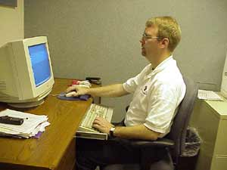
Good sitting posture

Slide 80
Challenges to Implementing an Environmental Stewardship Programme

Slide 81
Barriers for Environmental Stewardship
Individual
Feeling that small individual actions don’t make a difference.
Lack of understanding of the connection between people and the environment.
Perception that “green” products are more costly and of a lower quality; reluctance to accept cost or quality penalties with purchases.
Reluctance to make lifestyle shifts to accommodate stewardship behaviour.

Slide 82
Barriers for Environmental Stewardship
Companies
Lack of accountability and responsibility
Lack of well documented connection between environmental stewardship and economic benefits / good business practices
Consumer perception that “green” products are more costly and of lower quality
Majority of capital markets are not yet measuring and valuing environmental performance and stewardship
Difficulty of changing workplace culture

Slide 83
Barriers for Environmental Stewardship
Companies cont’d
Lack of sufficient technical assistance for small and mid-size businesses.
Lack of economic signals in the market place.
Government Organisations
Lack of accountability and responsibility
The term “environmental stewardship “ is not widely used among government agencies
Lack of alignment between stewardship and regulations.
Difficulty of changing workplace culture

Slide 84
Thank You!

